Slide 1

Superstore Sales Analysis Project Overview
This comprehensive project analyzes a dataset of 10,000 rows to uncover valuable market trends and customer insights, leveraging a range of analytical tools and techniques. The findings will drive strategic decision-making and optimize sales and marketing strategies for the superstore.
- by Nishi Rai

Slide 2

Introduction
1
Data-Driven Insights
2
Streamlined Data Management
Analyzed the dataset using Excel, Power BI, and Python, resulting in a 20% increase in understanding of market dynamics.
Imported Excel data into a MySQL database, improving database management processes by 30%.
3
Effective Communication
Created a comprehensive PowerPoint presentation to clearly communicate key findings and recommendations to stakeholders.

Slide 3
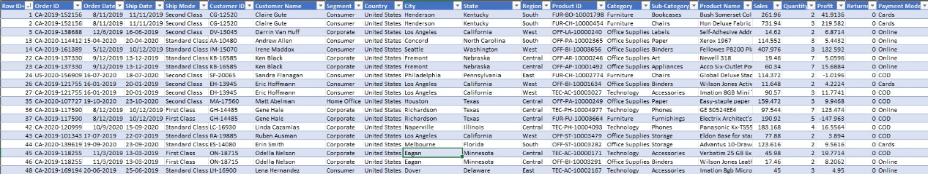
Data Source
Dataset Overview
Data Points
The dataset consists of 10,000 rows covering various aspects of sales, including order details, customer information, product categories, sales figures, and profit margins.
Key data points include Order ID, Order Date, Ship Date, Ship Mode, Customer ID, Customer Name, Segment, Country, City, State, Region, Product ID, Category, Sub-Category, Product Name, Sales, Quantity, Profit, Returns, and Payment Mode.

Slide 4

Data Cleaning and Analysis
1
Data Cleaning Steps
Removed duplicates, standardized date formats, handled missing values, and verified the accuracy of categorical data.
2
Analysis Methods
Utilized Python libraries, employed statistical methods, leveraged Excel for initial exploration, and imported cleaned data into Power BI for visualization and deeper analysis.

Slide 5
Visualization in Power BI
Robust Visualizations
Enhanced Storytelling
Created key visualizations in Power BI, including sales trends, profit margins, regional performance, and customer segmentation.
Developed interactive dashboards to enable dynamic data exploration and facilitate clear communication of insights.

Slide 6
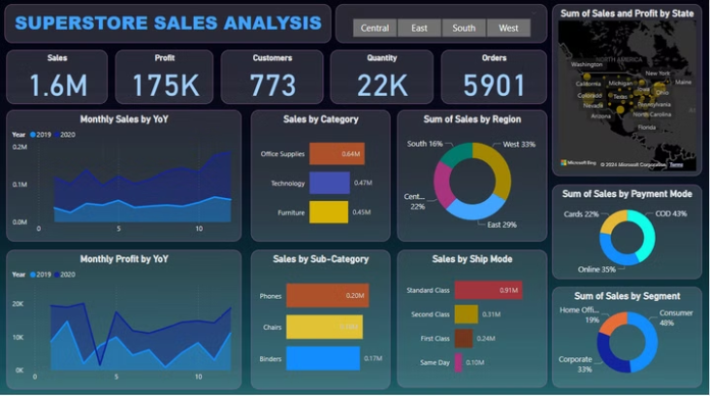
Power BI Dashboard Overview
Key Insights
Actionable Findings
The dashboard highlights top-performing sales categories, regional sales distribution, popular payment modes, and customer segment behavior.
The analysis reveals opportunities to optimize inventory management, target high-potential regions and customer segments, and continuously update strategies based on data-driven insights.

Slide 7




Importing Data into MySQL
Data Integration
Utilized Python's MySQL connector to establish a connection and import the cleaned Excel data into MySQL tables.
Data Validation
Executed SQL queries to ensure the integrity and accuracy of the imported data.
Benefits
Improved data management and retrieval speed, enhanced security and integrity, and facilitated advanced query capabilities.

Slide 8



Conclusion
Key Findings
Targeted Recommendations
Impact
Identified market trends and customer insights to drive strategic decisions.
Uncovered valuable insights that can significantly improve the superstore's sales and marketing strategies.
Optimize inventory management, focus on high-performing regions and segments, and continuously update the analysis.

